Slide 1

COVID-19
Does the end of the pandemic and COVID programs hurt citizens more than the benefits provided ruing the pandemic

Slide 2
Research Theory: Is the official end of the COVID-19 Public Health Emergency (PHE) and removal of its associated benefits going to hurt US Citizens more than the benefits they provided during the three-year pandemic?
Notes:
In my career with the State I was heavily involved in the data supporting the Public Health Emergency (PHE) response. We leveraged state and federal support with programs to help citizens survive. My question in relation to this has to do with the PHE ending. With it ending and removal of benefits going to hurt people more than the short term benefits they provided?
This will be evaluated through five questions on specific programmatic changes or adjustments that were implemented nation wide.

Slide 3
1. The Medicaid Unwind will remove people from health care that really need it.
People on Medicaid that no longer qualify will be removed from coverage – leaving them without healthcare.
An estimated 7-24 million citizens nationwide could lose coverage.
Vulnerable populations and those that do not speak English as their primary languages are at higher risk of losing coverage due to limited resource available to assist them.
Notes:
During the pandemic, the Federal government waived the recertification for people to keep their Medicaid coverage. This allowed people who were qualified and had Medicaid prior to the pandemic to continue receiving benefits, and those that started Medicaid during the pandemic kept benefits without having to go through recertification. This exception ended April 2023, requiring states to recertify everyone. Some states are doing it as the recipient comes up for renewal, other did their entire population all at once.

Slide 4
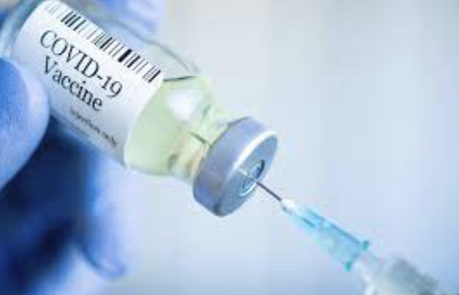
2. Not having free vaccinations available to all will increase disease spread.
Many citizens will not have Medicaid.
Vulnerable populations will not be able to get vaccinated.
Cost will become a factor in virus spread control.
Notes:
On top of some citizens losing Medicaid coverage, federal funding for free testing and vaccinations has expired. It has been proven that the vaccine is effective in limiting transmission and severity of disease.

Slide 5
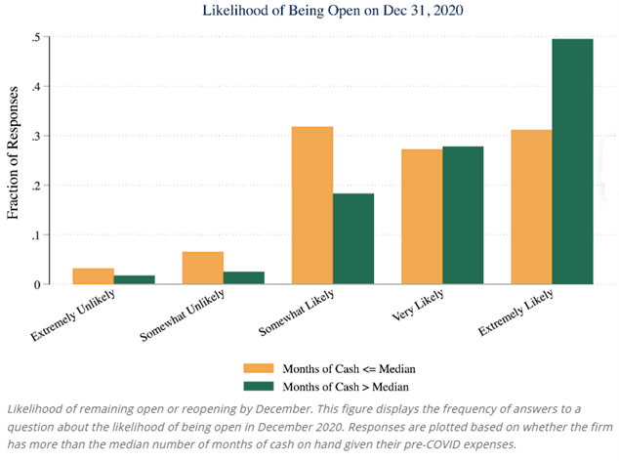
3. The business loans to essential businesses were only a band aid in helping them remain open.
Without the Federal assistance through loans, grants, and the paycheck protection program, many business would have closed by the end of the year.
Businesses were surveyed between March 28 – April 4, 2020 regarding the likelihood of being open at the end of 2020.
Notes:
With the lock down and quarantine impacting the nation for several months, the retail, entertainment, food services and hospitality industries were hit the hardest with the lack of customers. Some were able to adapt (online ordering, carryout only, curbside groceries) and others could not (hotels remained empty and concerts were cancelled). Surveys were completed by the Proceedings of the National Academy of Sciences to business to evaluate impact and need for financial assistance.

Slide 6
4. Restarting student loan payments will hurt families financially.
Interest on loans was suspended by the President.
Payment suspension was announced the following week.
People have not been making payments for over 3 years.
Citizens have major concerns about the ability to begin repayment as their financial situation has changed.
Notes:
On March 13, 2020, President Trump announced the elimination of interest on federal student loans on the 42 million Americans with more than a total of $1.5 trillion outstanding in loans (Stratford, 2020). The following week, the US. Department of Education announced the suspension of payments for two months, which has now turned into more than three years (Custer, 2022).

Slide 7
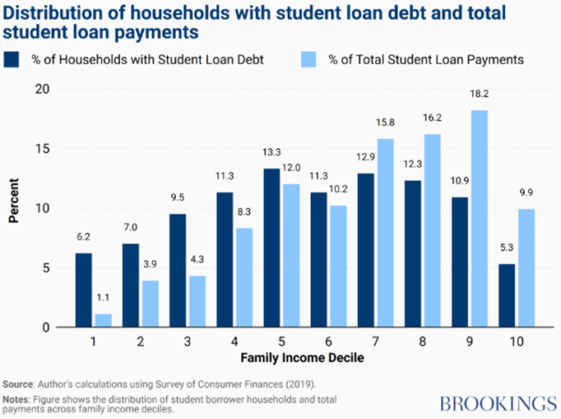
5. The student loan discharge will only help a portion of the Citizens in the country.
Because of the distribution of student loans by income, those that have higher incomes will benefit more from the changes in student loan programs because they have higher debt amounts outstanding.
Notes:
The Federal government adjusted the Public Service Loan Forgiveness (PSLF) waver to allow more people to qualify for that student loan discharge program. The income-driven repayment method was adjusted to make payments, when resumed, more affordable. Additionally, students who attended institutions where they misled, defrauded or lied were granted automatic discharge of their loans. The President was also pushing for a flat rate discharge for loan holders but that got stopped by the supreme court. For those with student loans, when you look at the percentage that have payments compared to the amount of the payment, you can see that higher income households have fewer loans but those that do have a higher loan amount.

Slide 8
Conclusion
The front-line response for the pandemic was testing and vaccination. It has been proven those were effective in controlling spread and severity of illness.
From a financial perspective, those programs that supported small businesses were successful.
The changes to the student loan programs have been the most confusing and their outcomes still hve unknown impact on the citizens.

Slide 9
References:
Bartik, A., Bertrand, M., Cullen, Z., Glaeser, E., Luca, M., and Stanton, C. (2020). The impact of COVID-19 on small business outcomes and expectations. National Library of Medicine, DOI 10.1073/pnas.2006991117. https://www.ncbi.nlm.nih.gov/pmc/articles/PMC7395529/
CBPP. (2023, April 28). Unwinding the Medicaid Continuous Coverage Requirement. https://www.cbpp.org/research/health/unwinding-the-medicaid-continuous-coverage-requirement
Centers for Disease Control and Prevention. (2023, March 15). CDC Museum COVID-19 Timeline. https://www.cdc.gov/museum/timeline/covid19.html
Centers for Disease Control and Prevention. (2023, May 11). COVID Data Tracker. https://covid.cdc.gov/covid-data-tracker/#vaccinations_vacc-total-admin-rate-total
CRFB. (2020, December 21). What's in the Final COVID Relief Deal of 2020? https://www.crfb.org/blogs/whats-final-covid-relief-deal-2020
CRFB. (2021, January 7). Breaking Down $3.4 Trillion in COVID Relief. https://www.crfb.org/blogs/breaking-down-34-trillion-covid-relief#:~:text=Of%20the%20%243.4%20trillion%20in,from%20the%20other%20two%20bills.
Custer, B. (2022, August 9). Timeline: Federal Student Loans During the COVID-19 Pandemic. https://www.americanprogress.org/article/timeline-federal-student-loans-during-the-covid-19-pandemic/
Federal Student Aid. (2023). COVID-19 Loan Payment Paus and 0% Interest. https://studentaid.gov/announcements-events/covid-19/payment-pause-zero-interest
Google Trends. (2023, June 11). Millions lose Medicaid coverage. https://trends.google.com/trends/explore?date=today%203-m&geo=US&q=millions%20lose%20medicaid%20coverage
KFF. (2020, March 11). The U.S. Response to Coronavirus: Summary of the Coronavirus Preparedness and Response Supplemental Appropriations Act, 2020. https://www.kff.org/global-health-policy/issue-brief/the-u-s-response-to-coronavirus-summary-of-the-coronavirus-preparedness-and-response-supplemental-appropriations-act-2020/
KFF. (2020, March 18). The Families First Coronavirus Response Act: Summary of Key Provisions. https://www.kff.org/global-health-policy/issue-brief/the-families-first-coronavirus-response-act-summary-of-key-provisions/
KFF. (2020, April 9). The Coronavirus Aid, Relief, and Economic Security Act: Summary of Key Health Provisions. https://www.kff.org/coronavirus-covid-19/issue-brief/the-coronavirus-aid-relief-and-economic-security-act-summary-of-key-health-provisions/
KFF. (2023, June 29). 10 Things to Know About the Unwinding of the Medicaid Continuous Enrollment Provision. https://www.kff.org/medicaid/issue-brief/10-things-to-know-about-the-unwinding-of-the-medicaid-continuous-enrollment-provision/
Maeckelberghe, E. (2021, November 09). Ethical implications of COVID-19: vulnerabilities in a global perspective. https://academic.oup.com/eurpub/article/31/Supplement_4/iv50/6423457
Moghadas, S. M., Vilches, T. N., Zhang, K., Wells, C. R., Shoukat, A., Singer, B. H., Meyers, L. A., Neuzil, K. M., Langley, J. M., Fitzpatrick, M. C., & Galvani, A. P. (2021). The impact of vaccination on COVID-19 outbreaks in the United States. medRxiv : the preprint server for health sciences, 2020.11.27.20240051. https://doi.org/10.1101/2020.11.27.20240051. https://www.ncbi.nlm.nih.gov/pmc/articles/PMC7709178/
PNAS (Proceedings of the National Academy of Sciences). (2020, July 10). The impact of COVID-19 on small business outcomes and expectations. https://www.pnas.org/doi/10.1073/pnas.2006991117
Stratford, M. (2020, March 13). Trump to waive interest on federal student loans ‘until further notice’. https://www.politico.com/news/2020/03/13/trump-administration-student-loan-payments-suspension-128181
Turner, S. (2023, April 13). Student loan pause has benefitted affluent borrowers the most, others may struggle when payments resume. https://www.brookings.edu/articles/student-loan-pause-has-benefitted-affluent-borrowers-the-most-others-may-struggle-when-payments-resume/
U.S. Department of Health and Human services. (2023, May 9). Fact Sheet: End of the COVID-19 Public Health Emergency. https://www.hhs.gov/about/news/2023/05/09/fact-sheet-end-of-the-covid-19-public-health-emergency.html
The White House. (2022, March 12). FACT SHEET: Consequences of Lack of Funding for Efforts to Combat COVID-⁠19 if Congress Does Not Act https://www.whitehouse.gov/briefing-room/statements-releases/2022/03/15/fact-sheet-consequences-of-lack-of-funding-for-efforts-to-combat-covid-19-if-congress-does-not-act/
World Health Organization. (2023). Coronavirus disease (COVID-19). https://www.who.int/health-topics/coronavirus#tab=tab_1

